Slide 1
Figures for Smith et al. 2020

Slide 2
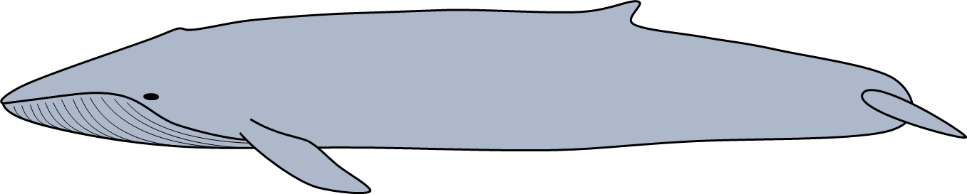
flow
path of flukes
orientation of fin
α
drag
path of animal
thrust
lift
Notes:
Figure 1. Adaptation from Shadwick (2005) showing the forces acting on the tail of a thunniform swimmer such as a blue whale during active oscillatory fluking of the tail. The heaving motion of the tail creates a pressure imbalance between the top and bottom faces of the fluke that results in the generation of a lift force perpendicular to the path of the flukes and a thrust force in the forward direction of travel of the animal.

Slide 3
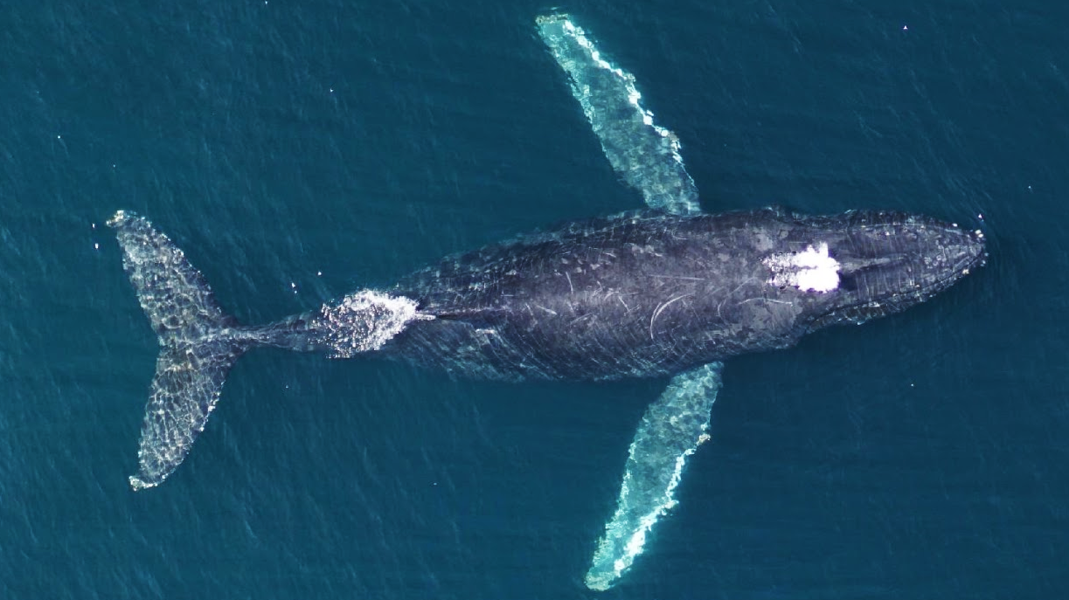
Notes:
Figure 2. Representative UAS drone image of a humpback whale showing the morphometric measurements taken from each animal. The orange line corresponds to the total length (in meters) from the tip of the lower jaw to the caudal midpoint of the tail. The chord length of the fluke (in meters) is denoted by the red line running from the cranial insertion of the fluke onto the peduncle to the caudal midpoint of the tail. The green shaded region corresponds to the tail area (in m²) comprising the entirety of the flukes and the peduncle region caudal to the cranial fluke insertions.

Slide 4
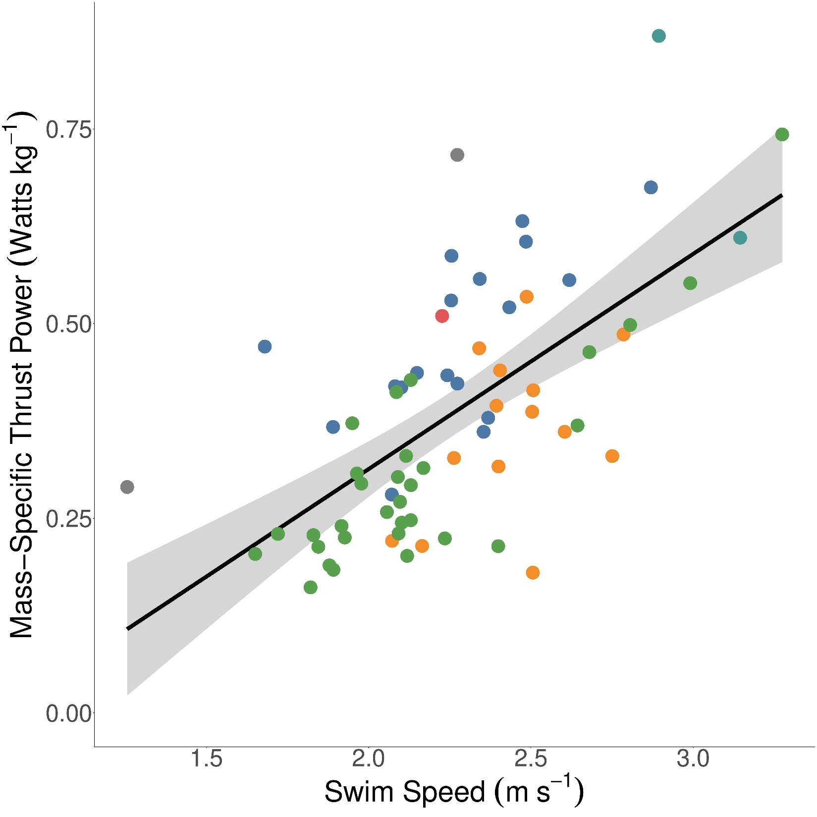
Blue
Humpback
Minke
Fin
Bryde’s
Sei
Notes:
Figure 3. Linear regression of mass-specific thrust (N kg⁻¹) versus swimming speed (m s⁻¹). Each point corresponds to the averaged value for a single individual whale. Green points are minke whales, orange points are humpback whales, and blue points are blue whales.

Slide 5
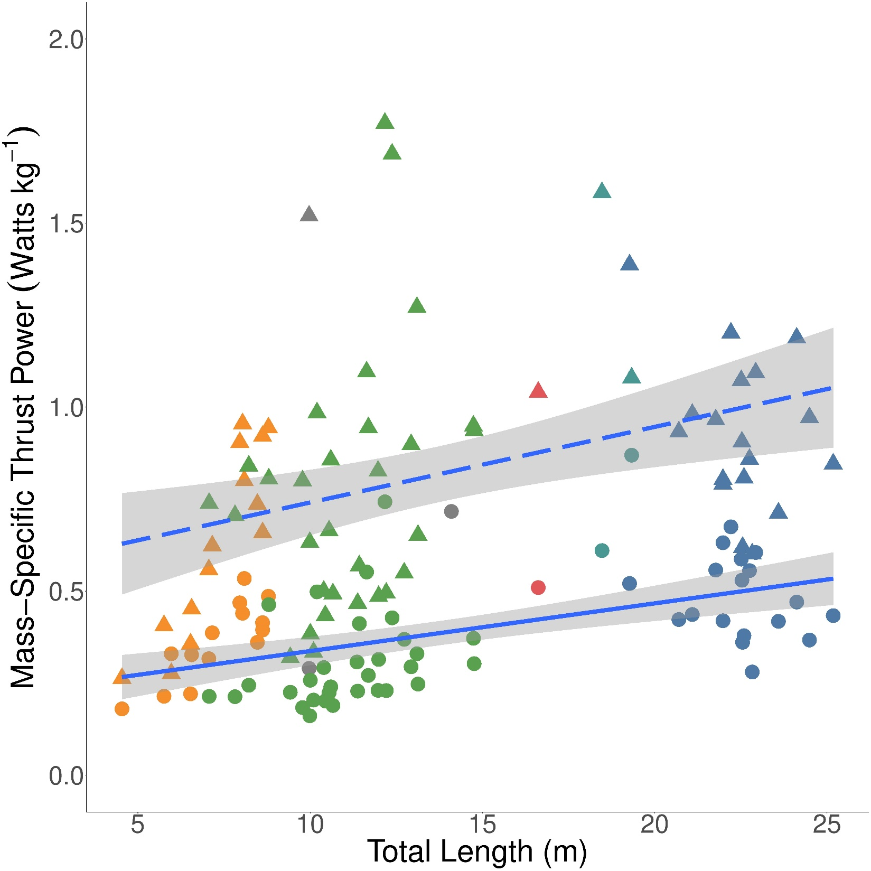
Blue
Humpback
Minke
Fin
Bryde’s
Sei
Notes:
Figure 4. Linear regressions of mass-specific thrust (N kg⁻¹) versus total body length (m) for both normal effort swimming (solid points and solid line) and maximum effort swimming (open crossed points and dotted line). Green, orange, and blue points correspond to minke, humpback, and blue whales.

Slide 6
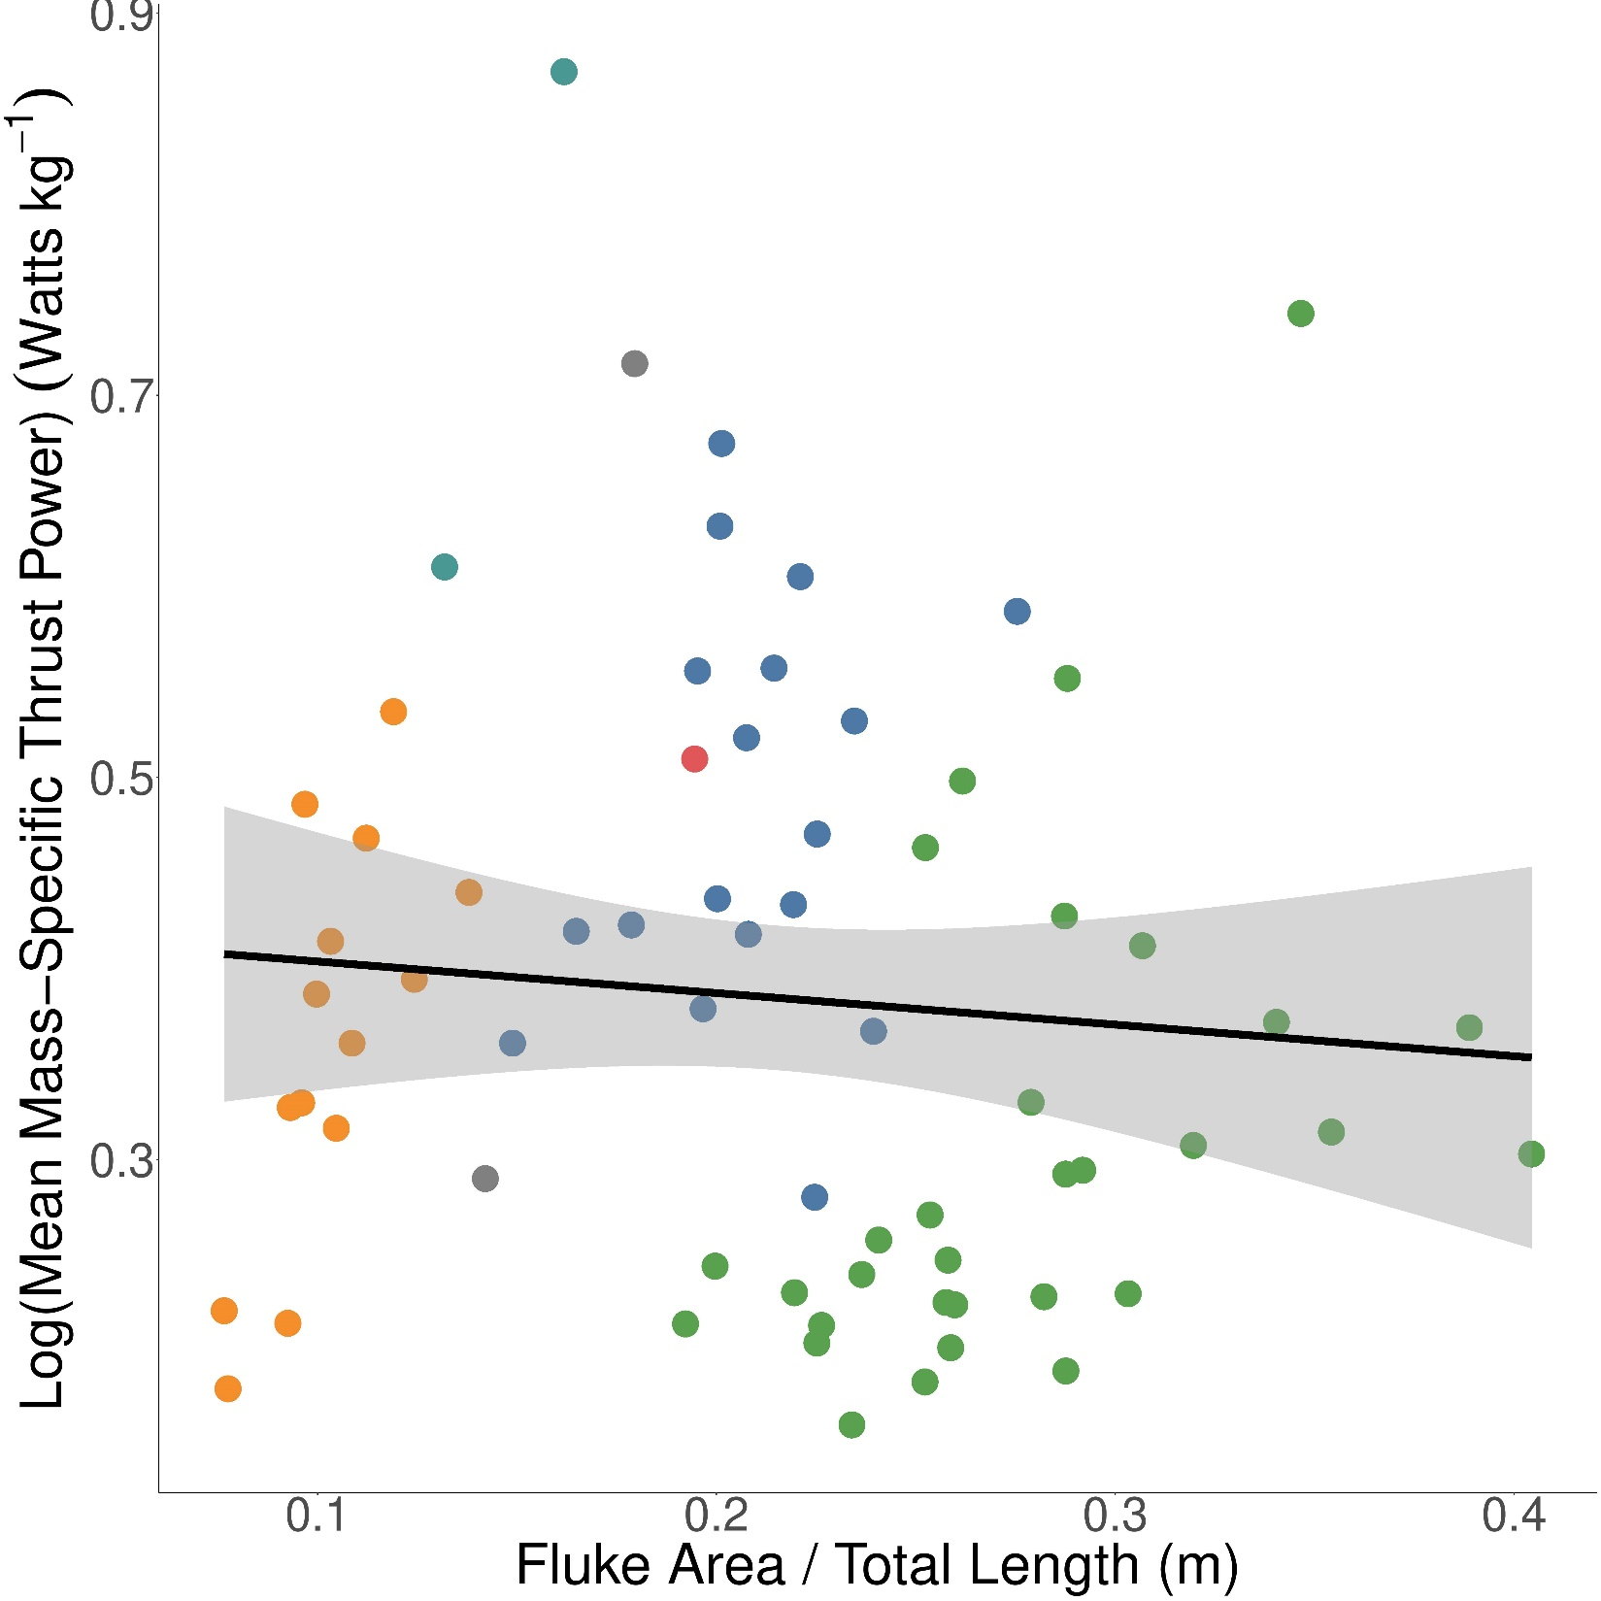
Blue
Humpback
Minke
Fin
Bryde’s
Sei
Notes:
Figure 5. Linear regression of mass-specific thrust (N kg⁻¹) versus the ratio of fluke area over total body length. Green, orange, and blue points correspond to minke, humpback, and blue whales.

Slide 7
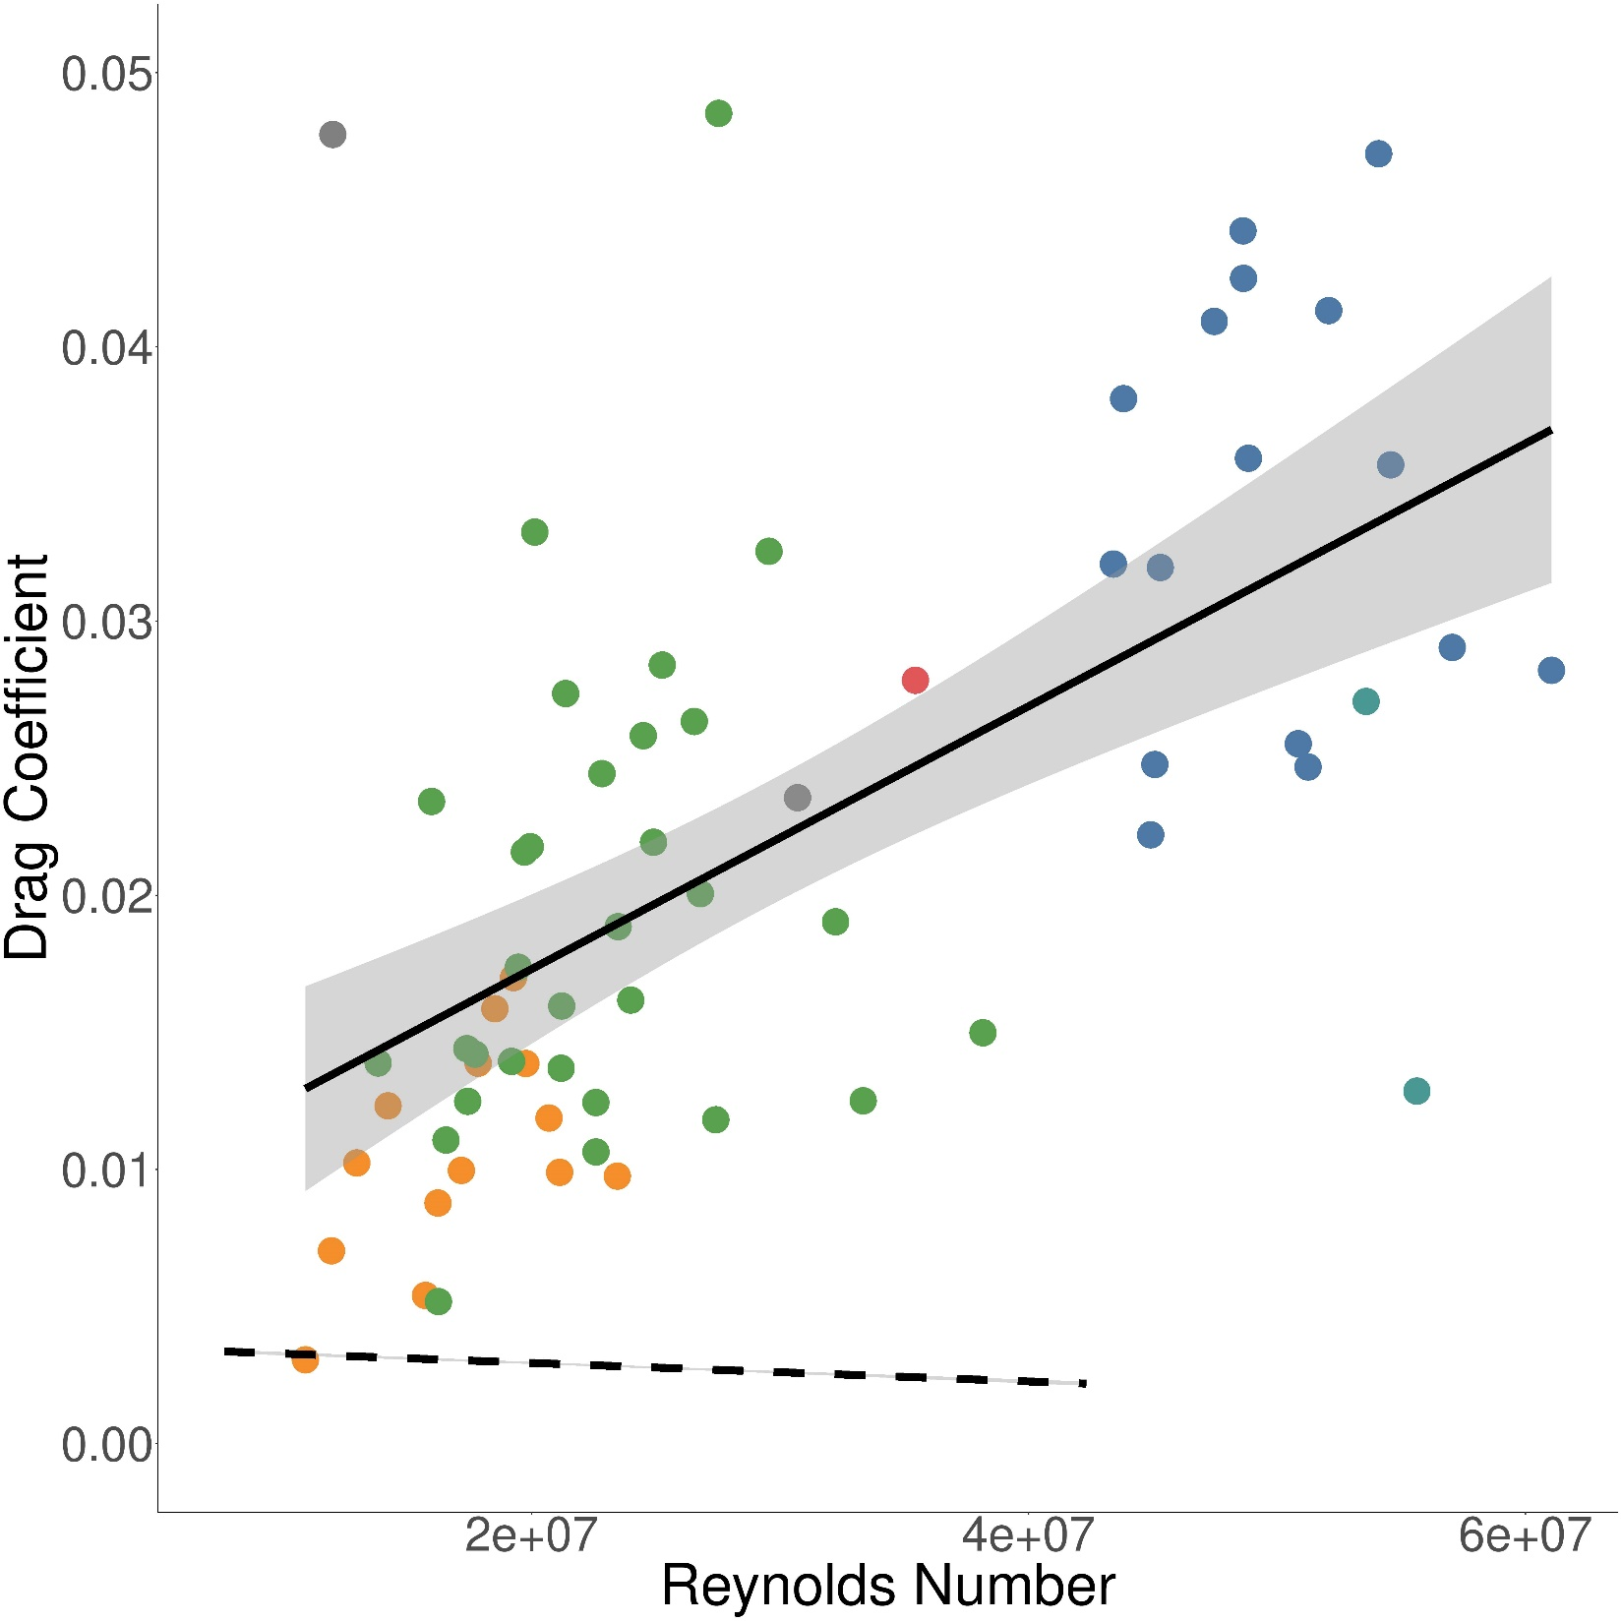
Empirical
Hoerner Model
Blue
Humpback
Minke
Fin
Bryde’s
Sei
Notes:
Figure 6. Linear regressions of drag coefficient versus Reynolds number for empirically-derived tag data (points and solid line) and a simple rigid-body model comparison using equations derived from Hoerner (1962) (dotted line). Green, orange, and blue points correspond to minke, humpback, and blue whales.

Slide 8
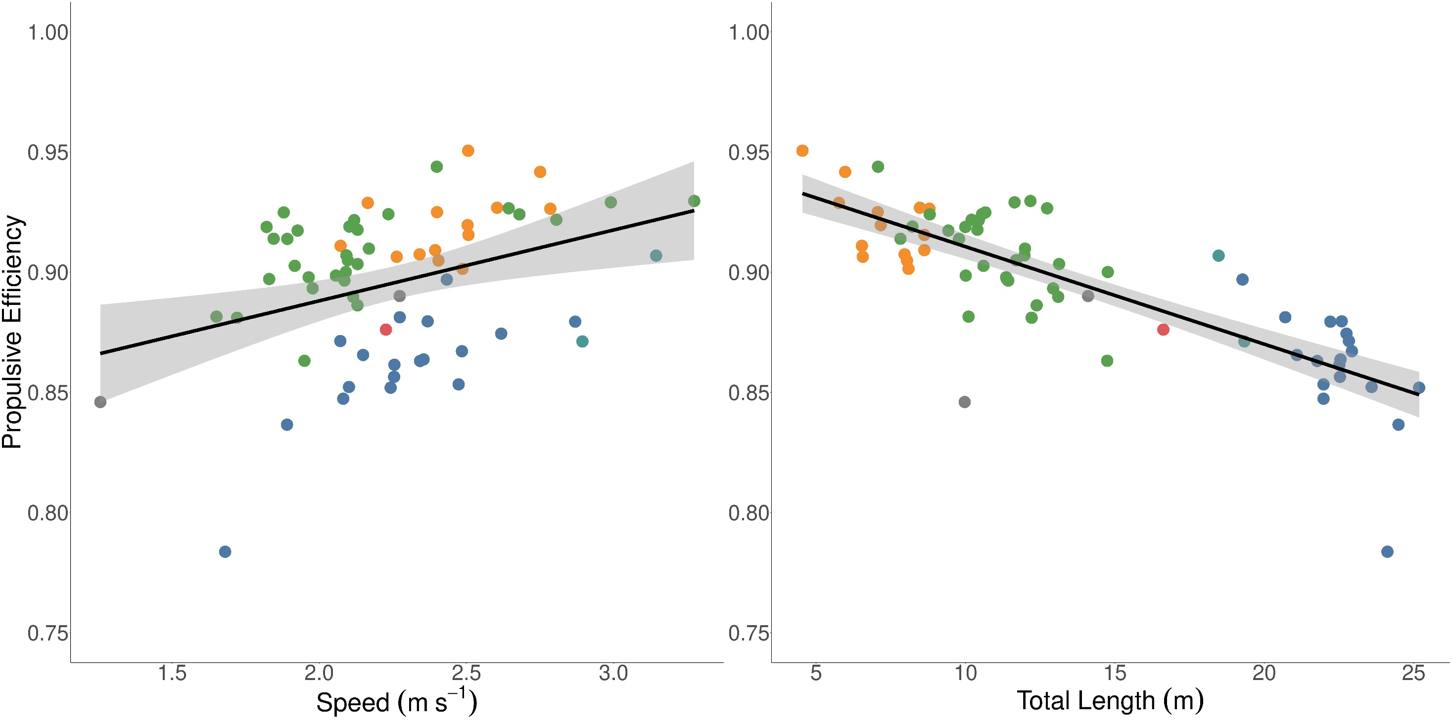
Blue
Humpback
Minke
Fin
Bryde’s
Sei
Notes:
Figure 7. Linear regressions of propulsive efficiency versus swimming speed (m s⁻¹) (left) and total body length (m) (right). Green, orange, and blue points correspond to minke, humpback, and blue whales.

Slide 9
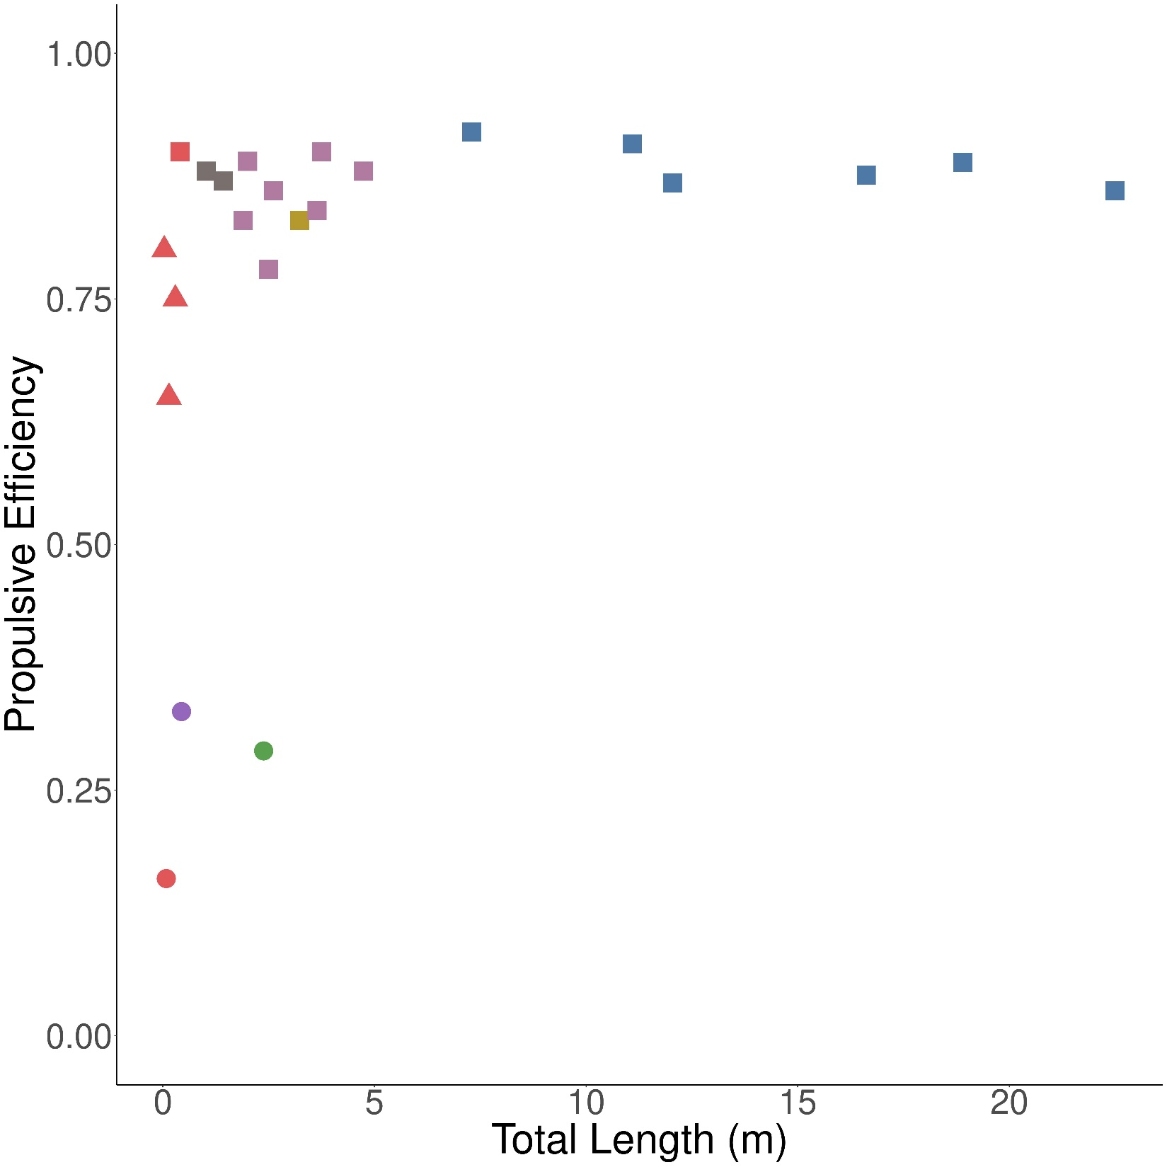

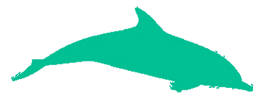
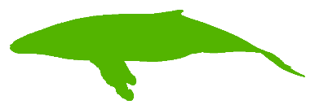
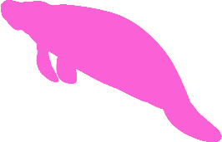
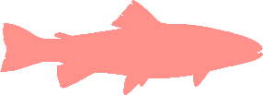
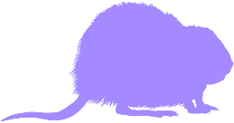
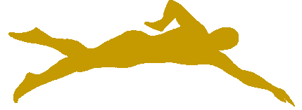
Oscillatory Swimming
Undulatory Swimming
Drag-Based Paddling
Mysticete Cetaceans
Odontocete Cetaceans
Pinnipeds
Sirenians (Manatee)
Fish
Rodents (Muskrat)
Humans
Notes:
Figure 8. Propulsive efficiency versus total body length (m) for species from different morphological and taxonomic groups and which use different swimming modes. Three of the four mysticete cetaceans are the averaged species-level minke whale, humpback whale, and blue whale data from the present study. Silhouettes correspond to each group by rough position and color.

Slide 10
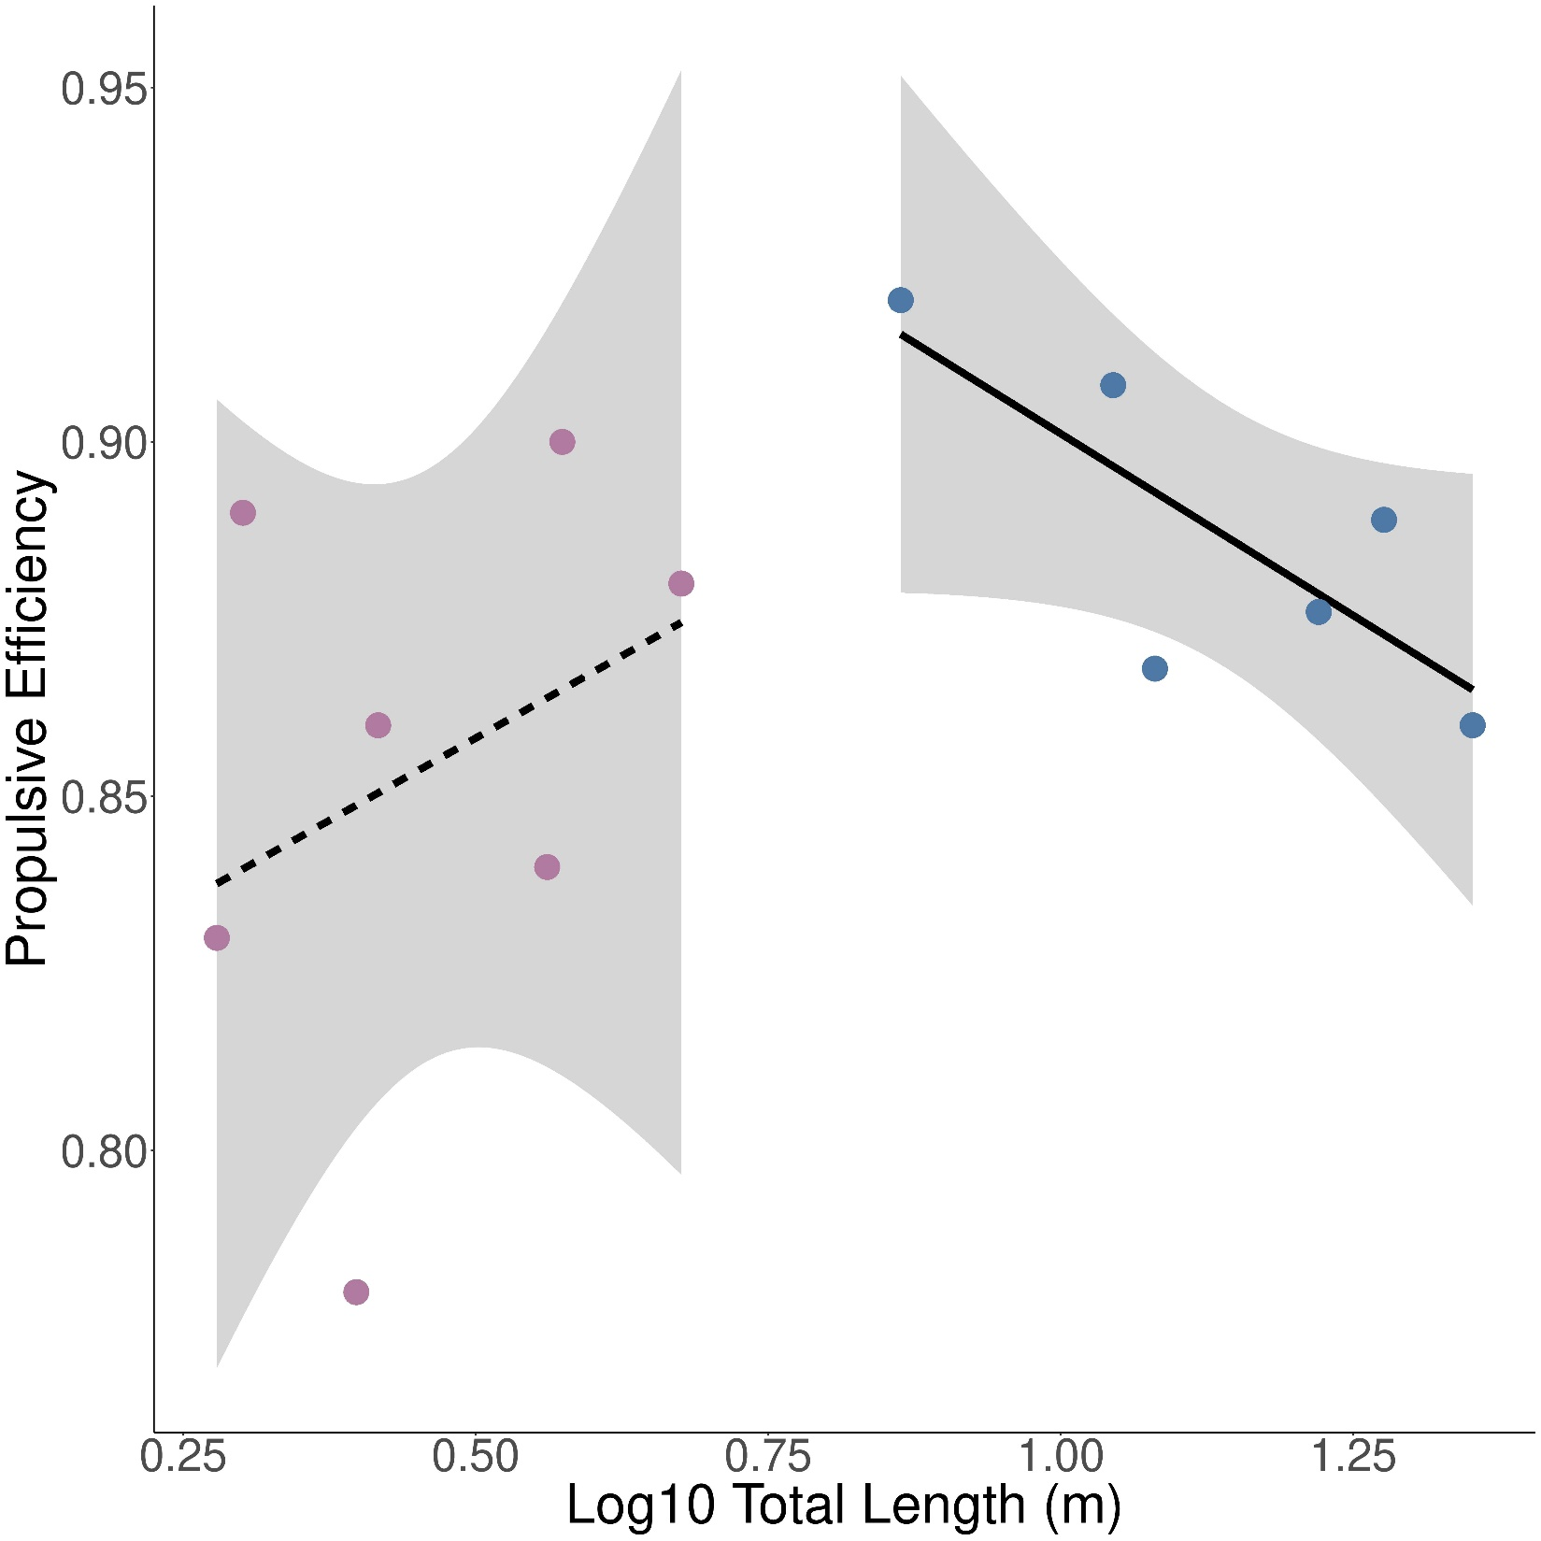
Mysticete Cetaceans
Odontocete Cetaceans

